Slide 1
MIPS Instruction-> Machine Instruction

Slide 2
MIPS Instruction Fields
MIPS fields are given names to make them easier to refer to
op rs rt rd shamt funct
op 6-bits opcode that specifies the operation
rs 5-bits register file address of the first source operand
rt 5-bits register file address of the second source operand
rd 5-bits register file address of the result’s destination
shamt 5-bits shift amount (for shift instructions)
funct 6-bits function code augmenting the opcode

Slide 3
How to Convert MIPS Instruction to Machine Language??
R-format used for Computational Category Instructions as
Computational Category-add/sub/and/or/nor
Shift Instructions-sll(Shift Left Logical )/srl(Shift Right Logical)

Slide 4
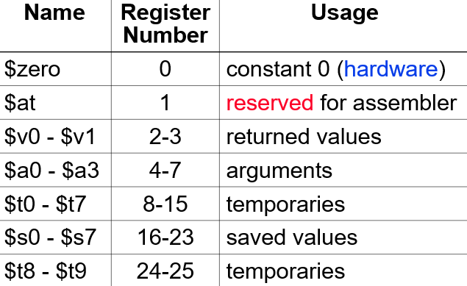
Register Conventions

Slide 5
MIPS Arithmetic Instructions
MIPS assembly language arithmetic statement
add $t0, $s1, $s2
add $t0, $s1, $s2
Each arithmetic instruction performs one operation
Each specifies exactly three operands that are all contained in the datapath’s register file ($t0,$s1,$s2)
destination ← source1 op source2
Instruction Format (R format) 17 is the code for 1st source register, mapping all 17,18 … into binary values
0 17 18 8 0 32
Notes:
Register designators (numbers) in decimal
Op codes and function fields in hex (0x designation)

Slide 6

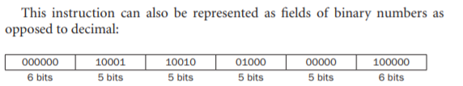
Given a MIPS add instruction…
Convert add $t0, $ t1, $t2 to Machine Language.
Machine Language In Hexadecimal Representation=(02324020)16

Slide 7
Revision Problem..
Convert sub $t0,$s1,$s2
Opcode=0 and Functional Code=34
Machine language in Hexa decimal Representation=(02324022)16

